Slide 1
Serious Game for Management of IT-Projects

Slide 2

Hello!
I am Ixhen Hasani
Born on 05.08.1994 in Tirana, Albania
Student on the 5.Semester B.Sc,
Field of study: Business Information Systems
Software developer working student at Sulzer GmbH

Slide 3
“If you do what you love, you'll never work a day in your life.”

Slide 4
And what do I love to do?
Code
From an idea, a requirement list is elicited. From that a plan is derived, and after a whole lot of hours of typing and even more bugs, a product comes to life, of which you can be proud. What‘s not to love about it ?
Business
The point system of life has as its basis the $. The more of this points collected, the more people you can reach a helping hand to, which is one of the biggest goals of my life.

Slide 5
Professional Goal
Programer
I
Business Manager

Slide 6
What is my project about?
A lot of IT projects fail
The Project Management Institute’s 2017 Pulse of the Profession report found that “due to poor project performance, organizations waste an average of $97 million for every $1 billion invested.”

Slide 7
What is my project about?
A lot of IT projects fail AND Management is the main factor
According to IBM “only 40% of projects meet schedule, budget and quality goals. Further, they found that the biggest barriers to success are people factors.”

Slide 8
What would a solution be?

Slide 9

Develop a Serious Game!

Slide 10
What is a Serious Game ?

Slide 11
Warum ein Serious Game ?
Mehr Engagement
“...The results we obtained so far lead us to believe that serious game design has a direct and indirect effect over student’s perceived acquired competency, which is mediated by student's engagement”
Bonazzi, R (2011). Analysis of Serious Games Implementation for Project Management Courses.

Slide 12
Warum ein Serious Game ?
Besseres Management
“...the Gamification of the educational part of project management actually leads to better managed projects in the real business environment.
Briers, B. (2013). The gamification of project management.

Slide 13

Wo kommt die Theorie her ?
PMBOK-Guide(Software Extension)
Definiert als Zusammenfassung des Wissens der Fachrichtung (Software)Projektmanagement
Kollektion von Best Practices und Vorgehensweisen für Management der IT-Projects

Slide 14
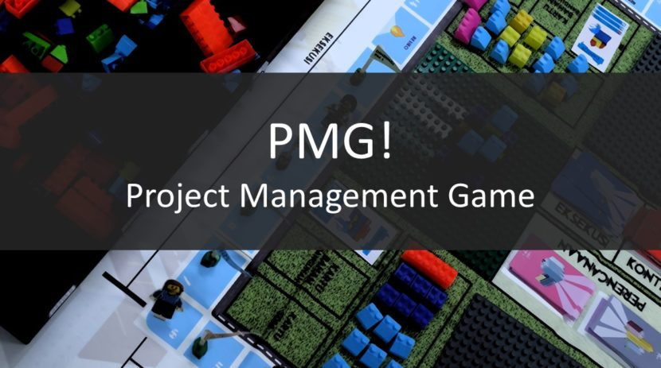
App Design
User bekommt die Erklärung eines Konzeptes in Snack-Size Minikapiteln
User wird durch Quizze, Lückentexten usw. nach bereits erklärten Konzepten gefragt
Punksystem einbauen, was den Fortschritt des Users abbildet.

Slide 15
Timeline
Android Studio Tutorials
(15.12-07.01)
Introduction & Recherche
(07.01-21.01)
RelatedWork und Theory
(21.01-06.02)
Coden & Development
(21.02-08.04)
Evaluation/Future Work/ Summary
(08.04-14.05)

Slide 16
Danke für die Aufmerksamkeit!
Fragen?

Slide 17
In two or three columns
Yellow
Is the color of gold, butter and ripe lemons. In the spectrum of visible light, yellow is found between green and orange.
Blue
Is the colour of the clear sky and the deep sea. It is located between violet and green on the optical spectrum.
Red
Is the color of blood, and because of this it has historically been associated with sacrifice, danger and courage.

Slide 18
Our process is easy
first
second
last

Slide 19
Problemstellung
The Project Management Institute’s 2017 Pulse of the Profession report found that “due to poor project performance, organizations waste an average of $97 million for every $1 billion invested.”
According to IBM “only 40% of projects meet schedule, budget and quality goals. Further, they found that the biggest barriers to success are people factors.”
Insert Chart Here, from PowerPoint on Windows
Notes:
https://www.cio.com.au/article/625522/why-it-projects-still-fail/

Slide 20
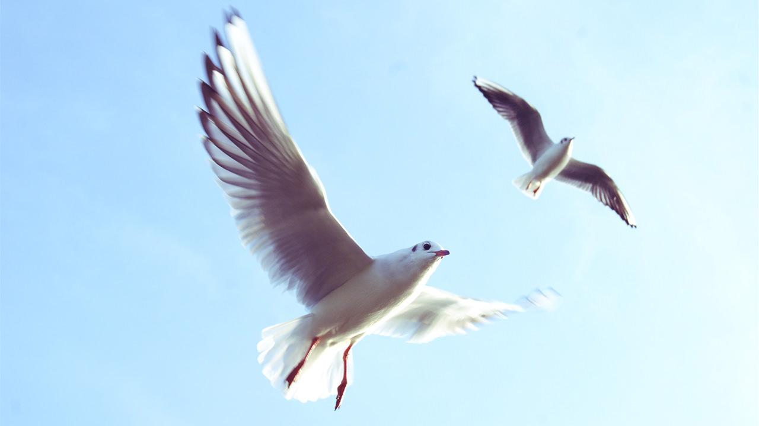
Want big impact?
Use big image.

Slide 21
And tables to compare data
 | A | B | C
Yellow | 10 | 20 | 7
Blue | 30 | 15 | 10
Orange | 5 | 24 | 16

Slide 22
Maps
our office

Slide 23
89,526,124
Whoa! That’s a big number, aren’t you proud?

Slide 24
89,526,124$
185,244 users
100%
That’s a lot of money
And a lot of users
Total success!

Slide 25
Our sales funnel
20%
40%
60%
80%
Diagram featured by http://slidemodel.com
100%

Slide 26
Let’s review some concepts
Yellow
Is the color of gold, butter and ripe lemons. In the spectrum of visible light, yellow is found between green and orange.
Blue
Is the colour of the clear sky and the deep sea. It is located between violet and green on the optical spectrum.
Red
Is the color of blood, and because of this it has historically been associated with sacrifice, danger and courage.
Yellow
Is the color of gold, butter and ripe lemons. In the spectrum of visible light, yellow is found between green and orange.
Blue
Is the colour of the clear sky and the deep sea. It is located between violet and green on the optical spectrum.
Red
Is the color of blood, and because of this it has historically been associated with sacrifice, danger and courage.

Slide 27
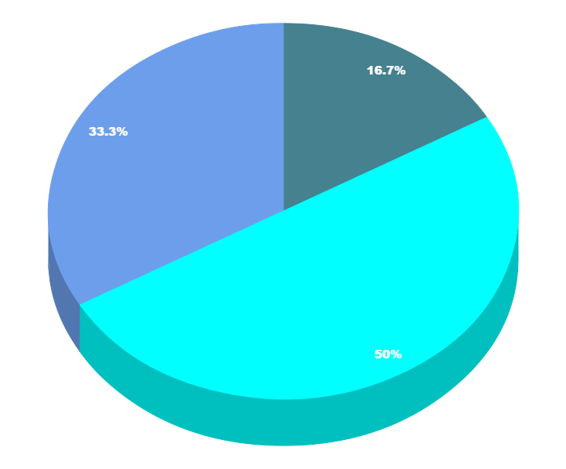
You can copy&paste graphs from Google Sheets

Slide 28
Place your screenshot here
Android project
Show and explain your web, app or software projects using these gadget templates.

Slide 29
Place your screenshot here
iPhone project
Show and explain your web, app or software projects using these gadget templates.

Slide 30
Tablet project
Show and explain your web, app or software projects using these gadget templates.

Slide 31
Place your screenshot here
Desktop project
Show and explain your web, app or software projects using these gadget templates.

Slide 32
Credits
Special thanks to all the people who made and released these awesome resources for free:
Presentation template by SlidesCarnival
Photographs by Unsplash

Slide 33
Presentation design
This presentation uses the following typographies and colors:
Titles: Nixie One
Body copy: Muli
You can download the fonts on this page:
https://www.fontsquirrel.com/fonts/nixie-one
https://www.fontsquirrel.com/fonts/muli
Aquamarina #00e1c6 / Turquoise #19bbd5 / Skyblue #2c9dde /
Light gray #c6daec / Dark blue #0e293c
You don’t need to keep this slide in your presentation. It’s only here to serve you as a design guide if you need to create new slides or download the fonts to edit the presentation in PowerPoint®

Slide 34
SlidesCarnival icons are editable shapes.
This means that you can:
Resize them without losing quality.
Change fill color and opacity.
Change line color, width and style.
Isn’t that nice? :)
Examples:

Slide 35
😉
Now you can use any emoji as an icon!
And of course it resizes without losing quality and you can change the color.
How? Follow Google instructions https://twitter.com/googledocs/status/730087240156643328
✋👆👉👍👤👦👧👨👩👪💃🏃💑❤😂😉😋😒😭👶😸🐟🍒🍔💣📌📖🔨🎃🎈🎨🏈🏰🌏🔌🔑 and many more...

